Slide 1
PRICE DISCRIMINATION
MGCR 293
Professor: Dr. K. Salmasi
Dr. Taweewan Sidthidet
Dr. Tariq Nizami
T.A.: Mike Brintnell
Presentation Credit: Brianna Mooney

Slide 2
CHAPTER REVIEW

Slide 3
PRICE DISCRIMINATION
Price discrimination occurs when the same product is sold for more than one price (e.g., an airline might sell tickets on a particular flight at different prices to business-people vs students)
Three Types of Price Discrimination:
First degree
Second degree
Third degree

Slide 4
FIRST DEGREE PRICE DISCRIMINATION
Charge each customer a different price for the same product in order to extract all consumer surplus.

Slide 5
FIRST DEGREE PRICE DISCRIMINATION
Each customer is charged their reservation price
100% of consumer surplus is captured by the selling firm
Usually only works when there is a small number of buyers and the seller can estimate each of their reservation prices.

Slide 6
SECOND DEGREE PRICE DISCRIMINATION
Price charged to customers depends the amount they consume (e.g. utility companies)
Price per unit decreases as consumers reach certain established consumption thresholds
Works at a group level rather than an individual level, therefore some social welfare is retained by consumers

Slide 7
SECOND DEGREE

Slide 8
THIRD DEGREE PRICE DISCRIMINATION
The “segment” and “seal” method
Demand must be heterogeneous, managers must be able to identify and segment the different markets
Markets must be sealed off from one another
Next best thing to first degree; identify individuals with similar price elasticities and group them together
A different price is charged for the same product sold in different markets/to different classes of consumers

Slide 9
PROFIT MAXIMIZING OUTPUT
To maximize profit, the firm produces an output where the firm’s MC is equal to the common value of MR for each of the segments (markets/classes). Output is then allocated to each segment such that this condition is true.
MR in one segment = MR in other segment
Since MR = P(1 + 1/η), the ratio of price in the first class to the price in the second class will be:
P₁/P₂ = (1 +1/η₂) / (1 +1/ η₁)
If the two price elasticities are equal, it will not pay-off for the firm to price discriminate. In fact, P₁ = P₂

Slide 10
PEAK LOAD PRICING
Demand for goods and services shift with the time of day, week, or year
Price should be different during times of peak demand than times of low demand
MR peak differs from MR off-peak
MC peak differs from MC off-peak because at peak, production is at capacity, whereas at off-peak, there is excess capacity; therefore, causing MC to change (movement along the MC curve)
MR₁=MC₁ and MR₂=MC₂

Slide 11
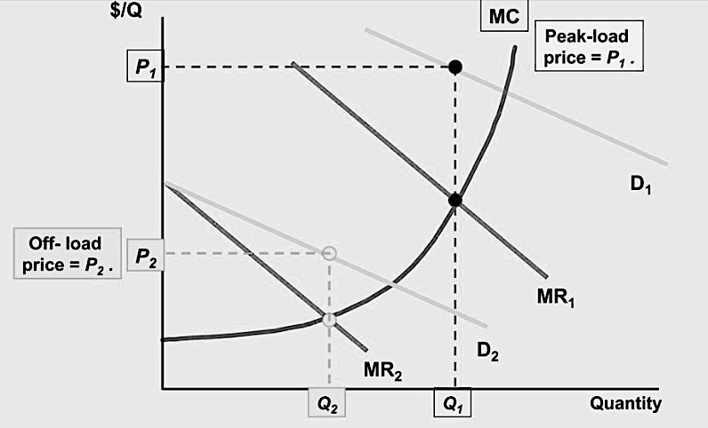

Slide 12
TWO PART TARIFF
Consumers pay two prices/fees:
an entry fee
a per use fee
Examples:
Amusement parks
Clubs (e.g. golf clubs)

Slide 13
TWO PART TARIFF : MODEL 1
Assumptions:
All consumers have the same preferences (ie: the same demand curve)
MC is constant (or could be upward sloping)
Per Use Fee = MC
Entry Fee = Consumer’s Surplus
Total revenue is the same as the total revenue earned using first degree price discrimination

Slide 14
TWO PART TARIFF : MODEL 1 – CONSTANT MC
$/Q
Usage price P* is set where
MC = P. Entry price T*
is equal to the entire
consumer surplus.
T*
consumer surplus
MC = AVC
P*
D
Quantity

Slide 15
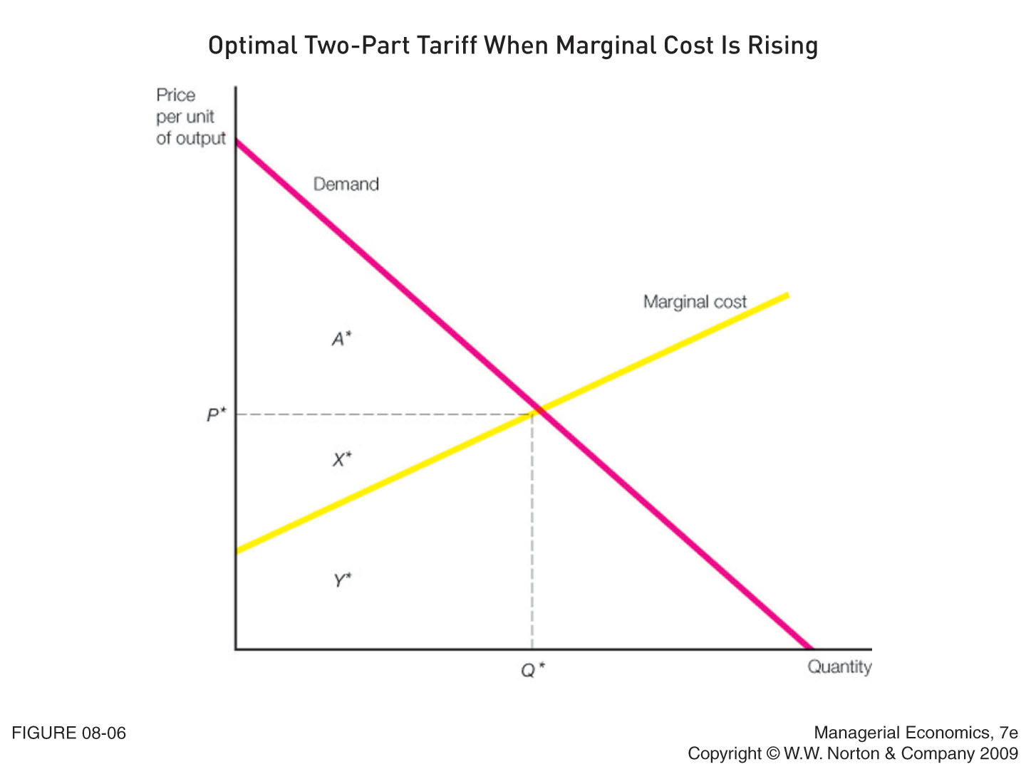
TWO PART TARIFF : MODEL 1 – UPWARD SLOPING MC
Usage price P* is set where
MC = P. Entry price T*
is equal to the entire
consumer surplus.

Slide 16
TWO PART TARIFF: MODEL 2
Assumption: Consumers do not have the same preferences (different demand curves)
Option 1:
Per use fee=MC
Entry fee=consumer surplus of the strong demander.
This will exclude the weak demander from the market.
Option 2:
Per use fee=MC
Entry fee=consumer surplus of the weak demander, both segments participate in market
Option 3:
Per use fee>MC (Profit off this)
Entry fee=consumer surplus of the weak demander.

Slide 17
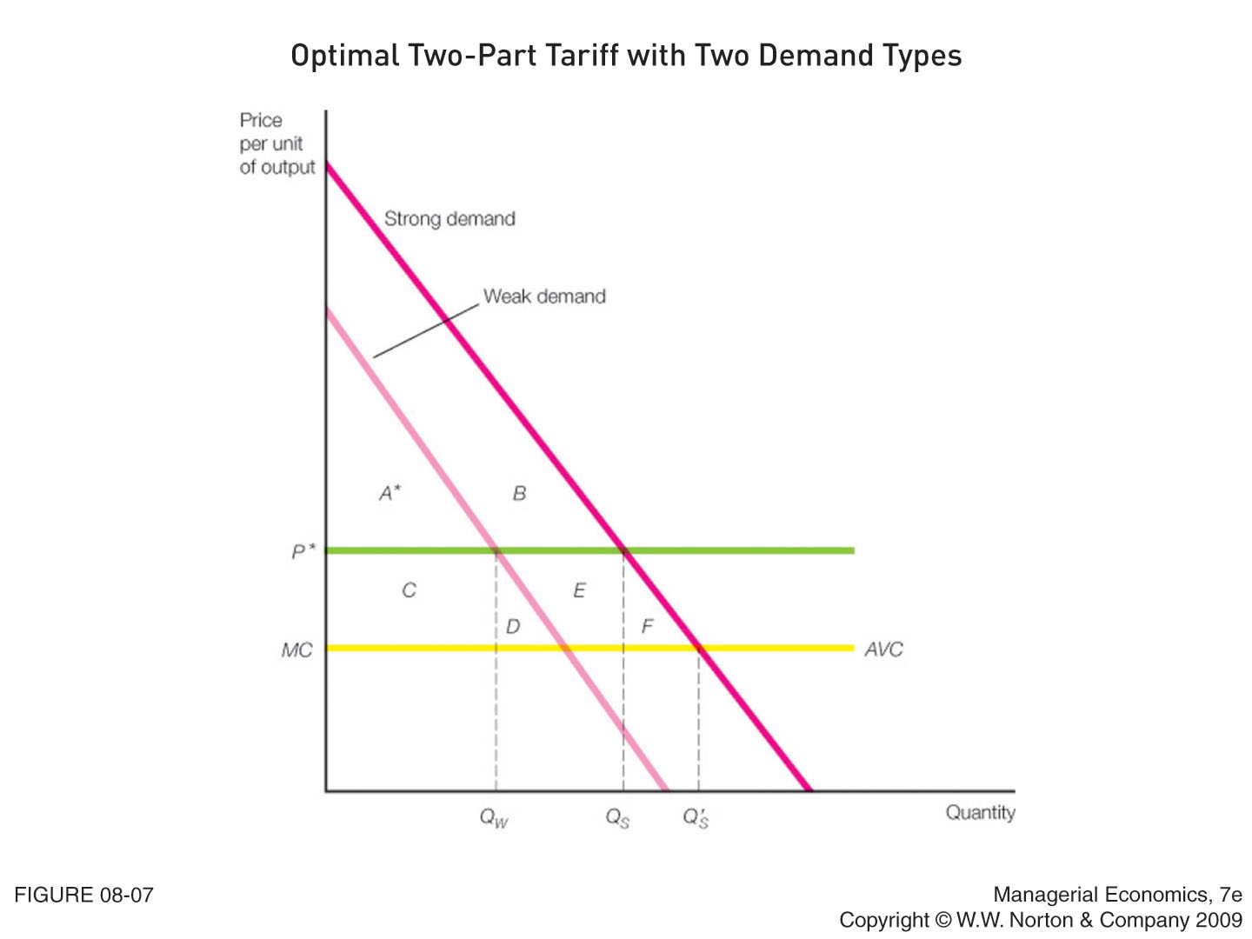
TWO PART TARIFF : MODEL 2

Slide 18
TWO PART TARIFF : MODEL 2
Goal: determine what entry and usage price to charge as to maximize profit
If the strong demander is willing to buy significantly more units at any price, then it is more profitable to charge a use fee equal to marginal cost and entry free equal to the consumer surplus of the strong demander (excludes weak demander)
If the strong demand is not that much stronger than the weak demand, managers should set the use fee at or above marginal cost and set the entry fee equal to the resulting consumer surplus of the weak demander

Slide 19
TWO PART TARIFF : MODEL 2
To include weak demander, must set usage fee (P*) which maximizes the area 2A* + 2C + D + E (if P* > MC) or 2A* + 2C + 2D (if P* = MC)
Once we determine the most profitable way to include both types of demanders, we must compare it to the profit earned by only serving the strong demander (A*+B+C+D+E+F)
Choose the method (either including both demanders or just the strong demander) that maximizes the firm’s profit

Slide 20
CHAPTER QUESTIONS

Slide 21
QUESTION 1
Medical device that they sell in Japan, Europe, and the United States.
The price elasticity of demand for the product is -4.0 in Japan, -2.0 in the United States, and -1.33 in Europe.
Once sold to a customer in one country, cannot be resold to a buyer in another country.
Recommendation that the price of the device be $1,000 in Japan, $2,000 in the USA and $3,000 in Europe. Comment on this recommendation.

Slide 22
SOLUTION
a)
In order to maximize profit, the MRs of each market must be equal: MR_{J}= MR_{U}= MR_{E}= MC_{F}
750=1000=750
Not all the MR’s are equal, so this is not the profit maximizing policy

Slide 23
QUESTION 1
b) His recommendations are accepted. Sales managers send reports to corporate headquarters saying that the quantity of devices being sold in the USA is lower than expected. Comment on their reports.

Slide 24
SOLUTION
b) Qu is lower because Pu is too high for the given price elasticity for USA.

Slide 25
QUESTION 1
c) After considerable argument, the U.S. sales manager agrees to lower the price in the USA to $1500. Is this a wise decision? Why or why not?
d) Can you be sure that managers are maximizing profit? Why or why not?

Slide 26
SOLUTION
c) MR_{US}=0.5*$1500=$750
^^This is consistent with the other countries, so given that the other countries are at profit maximizing price, this is a wise decision.
d)No, because we do not know the MC

Slide 27
QUESTION 2
Two distinct markets, completely sealed off from each other
The demand curve for the first market is
P₁= 160-8Q₁
The demand curve for the second market is P₂=80-2Q₂
The marginal cost curve is 5+Q, where Q is the firm’s entire output (destined for either market). Managers ask Ann McCutcheon to suggest a pricing policy.

Slide 28
QUESTION 2
How many units of output should she tell managers to sell in the second market?
How many units of output should she tell managers to sell in the first market?
What price should managers charge in each market?

Slide 29
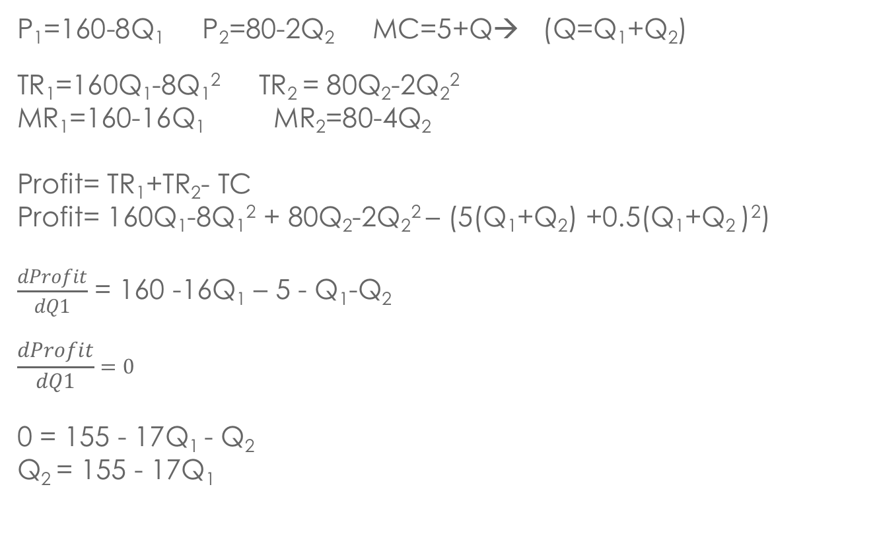
SOLUTION
P₁=160-8Q₁ P₂=80-2Q₂ MC=5+Q→ (Q=Q₁+Q₂)
TR₁=160Q₁-8Q₁² TR₂ = 80Q₂-2Q₂²
MR₁=160-16Q₁ MR₂=80-4Q₂
Profit= TR₁+TR₂- TC
Profit= 160Q₁-8Q₁² + 80Q₂-2Q₂² – (5(Q₁+Q₂) +0.5(Q₁+Q₂ )²)
$\frac{dProfit}{dQ1}$ = 160 -16Q₁ – 5 - Q₁-Q₂
$$\frac{dProfit}{dQ1}=0$$
0 = 155 - 17Q₁ - Q₂
Q₂ = 155 - 17Q₁

Slide 30
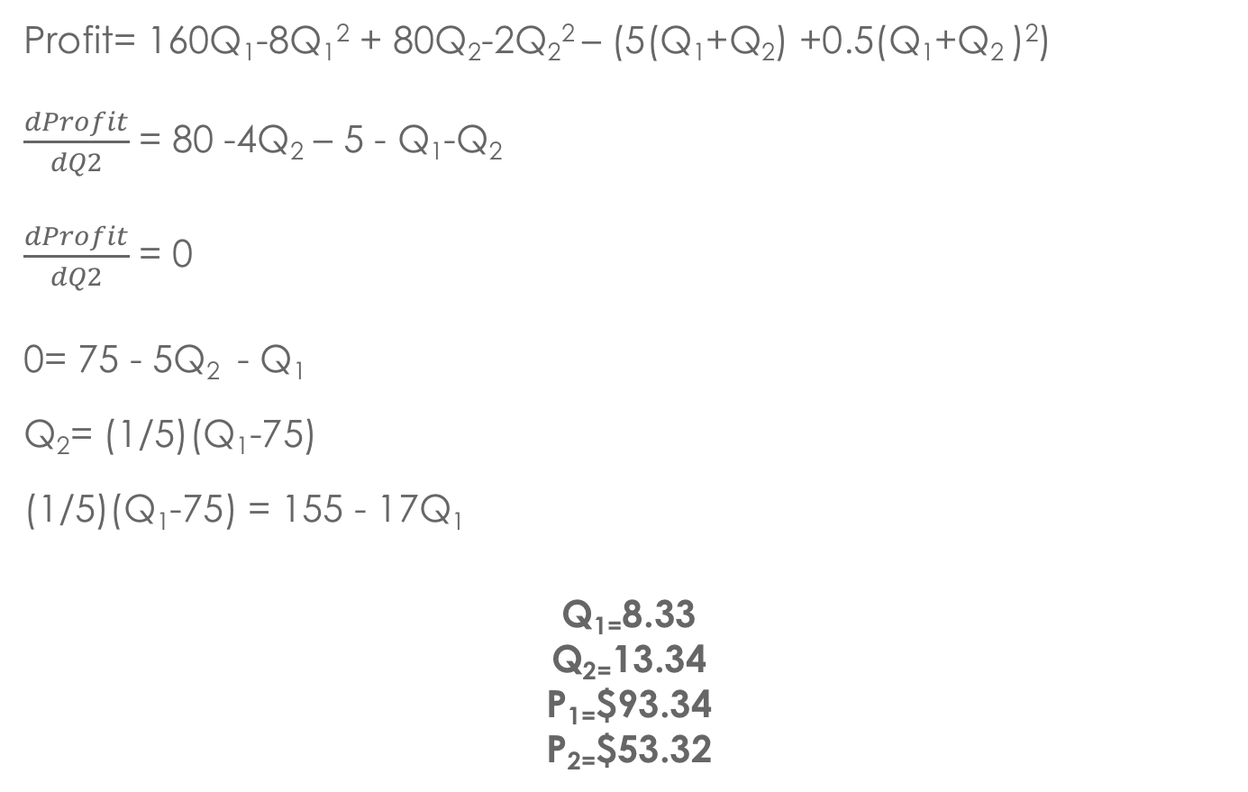
Profit= 160Q₁-8Q₁² + 80Q₂-2Q₂² – (5(Q₁+Q₂) +0.5(Q₁+Q₂ )²)
$\frac{dProfit}{dQ2}$ = 80 -4Q₂ – 5 - Q₁-Q₂
$\frac{dProfit}{dQ2}$ = 0
0= 75 - 5Q₂ - Q₁
Q₂= (1/5)(Q₁-75)
(1/5)(Q₁-75) = 155 - 17Q₁
Q₁₌8.33
Q₂₌13.34
P₁₌$93.34
P₂₌$53.32

Slide 31
Another way to solve…
P₁=160-8Q₁ P₂=80-2Q₂ MC=5+Q→ MC = 5+Q1+Q2 since (Q=Q₁+Q₂)
TR₁=160Q₁-8Q₁² TR₂ = 80Q₂-2Q₂²
MR₁=160-16Q₁ MR₂=80-4Q₂
MR1=MR2 = MC
Start with MR1:
160 – 16Q1 = 5 + Q1 + Q2
Q2 = 155 – 17Q1
Now with MR2:
80 – 4Q2 = 5+Q1+Q2
75 –Q1 =5Q2
Q2 = (1/5)(75-Q1)
Now solve the system of equations:
155 – 17Q1 = (1/5)(75-Q1)
Q1 = 8.33 -→ Q2 = 13.34. and P1 = $93.34 and P2 = $53.32

Slide 32
QUESTION 3
The demand curve for its services by the coal producer is P_{c}=495-5Q_{c}
The demand curve for its services by the producers of manufactured goods is P_{M}=750-10Q_{m}
The firm’s total cost function is TC=410+8(Q_{c}+Q_{m}) where TC is total cost (in thousands of dollars).

Slide 33
QUESTION 3
What price should managers charge to haul coal?
What price should managers charge to haul manufactured goods?

Slide 34
SOLUTION
π=TR_{c}+ TR_{M}-TC
π=495Qc + 5Qc² + 750Qm – 10Qm² - 410 – 8Qc – 8Qm
dπ/dQc=495 – 10Qc – 8=0
Qc=48.7
Pc=$251.50
b) dπ/dQm=750 – 20Qm – 8
Qm=37.1
Pm=$379

Slide 35
QUESTION 3
c) What if the prices have to be equal to each other? Will this increase or decrease profit?

Slide 36
SOLUTION
c) Pm=Pc=P
Q=Qm+Qc
Q=99 – 0.2P +75 – 0.1P
=174 – 0.3P
P=580 – 10/3Q → summation of two demand curves in terms of Q
MR=MC
580 -20/3Q=8
Q=85.8
P=$294

Slide 37
QUESTION 4
Consolidated Edison | Price – cents per kilowatt-hour
8 a.m. – 10 p.m. (peak hours) | 27
10 p.m. – 8 a.m. (off-peak hours) | 4
Pacific Gas and Electric | Price – cents per kilowatt-hour
Summer
Noon – 6 p.m. (peak hours) | 28.3
6 p.m. – Noon (off peak hours) | 9.2
Winter
Noon – 6 p.m. (peak hours) | 11.3
6 p.m. – Noon (off peak hours) | 8.0

Slide 38
QUESTION 4
Does price discrimination occur in the market for electricity?
Why have some state regulatory commissions, including the Public Service commission of NY, ordered that time-of-day rates be phased in for residential consumers?

Slide 39
SOLUTION
Yes, 2nd degree price discrimination
Time of day pricing has the effect of reducing peak demand for electricity. This reduces that average cost, conserves resources and reduces the need to add capacity to the power grid.

Slide 40
QUESTION 5
Imps:
Imps have a weak demand for tennis:
P_{I}=30 – Q_{I}
They are willing to pay an upfront fee
Wizards:
Pay for each game as they go along
P_{W}=40 – Q_{W}
There is an equal number of imps and wizards and MC=2. You can attract either wizards or imps but not both, what should you do?
Notes:
For imps: use option, set MC=Price (you don’t earn ANY profit from this)… all profit is generated from the “entry fee” which is the consumer surplus
- CS ½ * base * height = ½ * Q * (A-P) = ½ * Q * (30-2) = ½ *28*28 = 392
- Price is = MC , thus P=2
For Wizards: MR = MC
- MC =2
- TR = 40Q -2Q2 → MR 40-2

Slide 41
SOLUTION
Imps prefer the two-part tariff
MC=P, profit=consumer surplus entry fee
CS=0.5Q(30-P)=0.5(28)(28)=$392
MR=MC (wizards do not want two-part tariff)
40 – 2Q=2
Q=19, P=21
π= (19)(21) – (19)(2)=$361
Imps generate a greater profit using the two part tariff

Slide 42
QUESTION 7
The strong demander has a demand curve of:
P_{S}=6 – Q_{S}
The weak demander has a demand curve of:
P_{W}=4 – Q_{W}
MC=2 and FC=1 (fixed costs). There is one demander of each type.
Set up a two part tariff system to maximize profit.

Slide 43
SOLUTION
Strategy 1:
Charge per use fee=MC
Charge entry fee based on strong demand consumer surplus (this is the source of profit)
CS=π=0.5(6-2)(4)=$8
Strategy 2:
Charge per use fee=MC
Charge entry fee based on weak demand
CS=π=2*(0.5)(4 - 2)(2)=$4 → this is multiplied by 2, since this will attract both the strong and the weak demand

Slide 44
SOLUTION
Strategy 3:
Charge use fee >MC
Charge entry fee on weak demand
Must find total profit (2xconsumer surplus at unknown P + Quantity*(P - MC))
Qsold = Qs + Qw=6 – P + 4 – P → Q=10 – 2P
π=2*(0.5)(4 – P)(4 – P) + (P – 2)(10 – 2P)= -4 +6P – P²
dπ/dP=6 – 2P=0, P=3
π = -4 +6(3) – (3)²=$5

Slide 45
QUESTION 8
Demand Curve for University Employees:
P_{P}=30 – Q_{P}
Demand Curve for Non-University:
P_{N}=100 – Q_{N}
MC=6
Policy 1:
University Employees: Two-part tariff
Non-University: Price per visit only
Policy 2:
Different per visit price for each visitor, but no membership fee
What is the difference in profit of the two strategies?

Slide 46
SOLUTION
Policy 1:
For university members:
P=MC
30 – Qp=6
P=6, Qp=24
CS=0.5(24)(30 – 24)=$288
For non-university members:
MR=MC
6= -2Qn +100
Qn=47
P=53
π=47*(53 – 6)=$2209
Total profit=$288+$2209=$2497

Slide 47
SOLUTION
Policy 2:
For non-university members:
MR=MC
6= -2Qn +100
Qn=47
P=53
π=47*(53 – 6)=$2209
For university members:
MR=MC
6=30 – 2Qp
Qp=12, P=18
π=12(18 – 6)=$144
Policy 1 is the better one

Slide 48
Q&A

